Slide 1
Human Computer Interaction
Fundamentals and Practice [ SWE - 431 ]
Gerard Jounghyun Kim
Chapter: 9
Future of HCI
Mahfuzur Rahman Emon Lecturer, IICT, SUST

Slide 2


Human Computer Interaction
Chapter 9: Future of HCI
Four major computing platforms that have emerged in the past years:
Mobile and handheld platform: (exemplified by the smartphones) which we can carry around to compute and communicate.
Ubiquitous platform: In which everyday objects are embedded with interactive computing/networking devices and services
Natural and immersive computing/sensing/display platform: That provides near-realistic services and experiences
Cloud computing platform: That provides high-quality interactive services (based on its heavy-duty ultraserver level computing power) with real-time response (based on the fast network service).

Slide 3
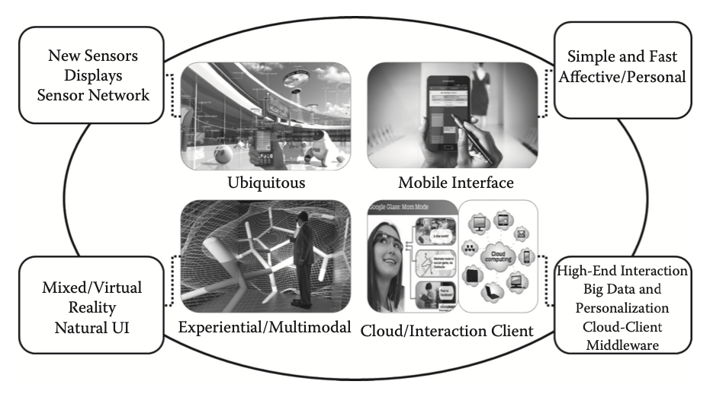
Human Computer Interaction
Chapter 9: Future of HCI
Four emerging computing platforms and associated HCI technologies to pay attention to in the next 10 years: high-quality cloud service and ubiquitous and mobile interaction clients experiential and natural user interfaces.

Slide 4
Human Computer Interaction
Chapter 9: Future of HCI
Cloud computing platforms allow users to access applications through client devices like desktops and mobile devices. These devices lack the power for high-end services like image recognition and language understanding, so the cloud handles the heavy lifting. The cloud serves as the Model, while client devices act as the View/Controller. This setup enhances user experience by providing real-time, high-quality services tailored to different types of clients. Middleware solutions are needed to ensure seamless connection between the Model and client View/Controllers.
Mobile and ubiquitous platforms are driving the integration of embedded computers and sensors into everyday objects, known as the Internet of Things. Touch technology, evolving to include multi touch and proximity sensing, dominates interaction with these devices.

Slide 5
Human Computer Interaction
Chapter 9: Future of HCI
The interaction styles of the mobile/embedded vs. natural/realistic interfaces can be understood in terms of people’s natural dichotomous desires: one for simple and fast operations in a dynamic environment and the other for a rich and experiential interaction in a more stable, relaxed environment. These two desires are in tune with the lifestyle in the coming ages as we become more aﬄuent and culturally richer. Virtual and mixed reality, multimodal interfaces are in the forefront of the experiential interaction technologies.
Interfaces are becoming more emotional, focusing on aesthetics, personalization, and adapting to users' changing needs. Achieving this requires advanced technology to sense contexts, user emotions, and intent, which is challenging even for humans. However, advancements in machine intelligence, like IBM Watson beating human champions, show promising progress.
In the following sections, we take a closer look at these promising HCI technologies, many of which are in an active stage of research

Slide 6
Human Computer Interaction
Chapter 9: Future of HCI
Non-WIMP/Natural/Multimodal Interfaces:
Considering various requirements and constraints, we found limited interface choices due to practical computing platform limitations (e.g., WIMP for desktop, touch-based for smartphones). However, as future computing platforms develop, we anticipate more options, including non-WIMP interfaces for natural and multimodal interactions.
Non-WIMP interfaces have been limited by issues like robustness and computational demands, but technological advancements and cloud computing are changing this landscape. We'll now assess future HCI technologies, including language understanding, gesture recognition, image recognition, and multimodal interaction.
Language Understanding:
The talking computer interface is undoubtedly the holy grail of HCI. Language understanding can be largely divided into two processes. The first is recognizing the individual words, and the second is making sense out of the sentence, which is composed of a sequence of recognized words

Slide 7
Human Computer Interaction
Chapter 9: Future of HCI
The current state of the art seems to be:
Over 95% recognition rate (individual words)
At least millions of words and more than 30 languages
In real time through the high-performance cloud
Without speaker-specific training
In a mid-level noisy environment
Voice recognition technology is advanced enough for widespread use but is particularly valuable in situations of disability support or when both hands are occupied, not everywhere, Reasons could be
Users are less tolerant to the 2%–3% of incorrect recognition performance
Segmentation problem ( quite diﬃcult to separate and segregate the actual voice input from the rest ‘noise, normal conversation’ within the stream of voice
Extracting the meaning from the words is another problem though the word level recognition is good enough.
Efforts are underway to improve voice/language understanding, exemplified by Apple Siri and IBM Watson. These technologies show promise for the future despite current limitations.

Slide 8
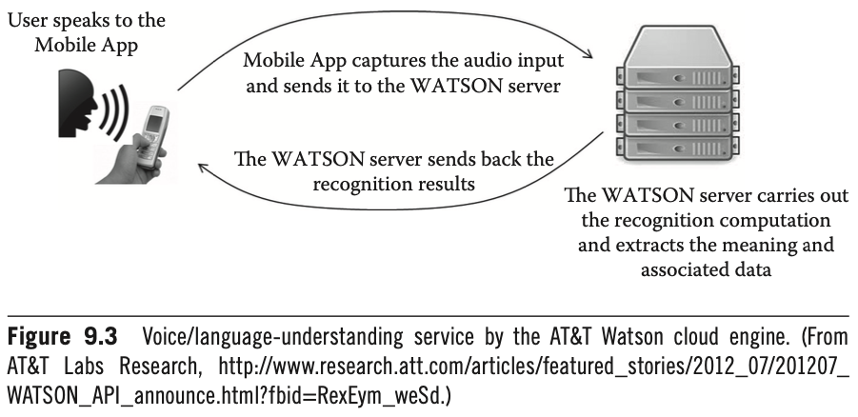
Human Computer Interaction
Chapter 9: Future of HCI

Slide 9
Human Computer Interaction
Chapter 9: Future of HCI
Gestures:
Gestures alone can convey meaning, or they can function in a supplemental role in other modes of communication.
the objective of incorporating gestures into human computer interaction is a natural outcome.
Gestures can be different types:
From human’s perspective (e.g. supplementary pointing vs symbolic)
Supplementary pointing" refers to gestures that assist in indicating or emphasizing something, often in conjunction with verbal communication. For example, pointing to a specific object while discussing it.
"Symbolic gestures" are non-verbal movements that represent abstract concepts or ideas. These gestures convey meaning without necessarily pointing to specific objects or locations. For instance, waving goodbye or making a thumbs-up gesture.
Technological viewpoint (e.g. static posture vs moving hand gestures)
A static posture refers to a gesture where the hand or body remains still without movement. It involves holding a particular position without changing or transitioning to another gesture. For example, holding one's hand up with fingers extended to signal "stop" or "wait" without any movement.

Slide 10
Human Computer Interaction
Chapter 9: Future of HCI
Hands/arms are used often for supplementary gestures (e.g., pointing) in verbal communication. For the hearing-impaired, the hands are used to express sign language.
Whether it is a static posture or involves movement of limb(s), must be captured over time. This is generally called motion tracking and can involve a variety of sensors that are targeted for many diﬀerent body parts
Two-dimensional (2-D) hand/finger tracking are the ones using the mouse and touch screen. [ direct contact with the device ]
In the case of the mouse, the user has to hold the device, and this is a source of nuisance, especially if the user is to express 2-D gestures rather than just using it freely to control the position of the cursor. This explains why mouse-driven 2-D gestures have not been accepted by users
Simple 2-D gestures on the touch screen, such as swipes and flicks, are quite popular.

Slide 11
Human Computer Interaction
Chapter 9: Future of HCI
With the rise of small and embedded computing devices, traditional 2-D touch input may not always be feasible due to space constraints.
Understanding gestures in three-dimensional space, similar to real-life movements, becomes crucial. This involves tracking the 3-D motion of body parts or objects.
Inside-Out Method: Requires sensors to be held or attached to the body or object being tracked (e.g., 3-D mouse, Wii-mote). Various mechanisms such as electromagnetic wave detection or inertial sensors are used. Inconvenience in some case due to the need for physical attachment.
Outside-In Method: Involves installing sensors external to the user's body (e.g., cameras or depth sensors like Microsoft Kinect). Users are free of attached devices, making movements feel more natural. However, tracking accuracy may be lower compared to inside-out methods due to the sensors being remote.

Slide 12
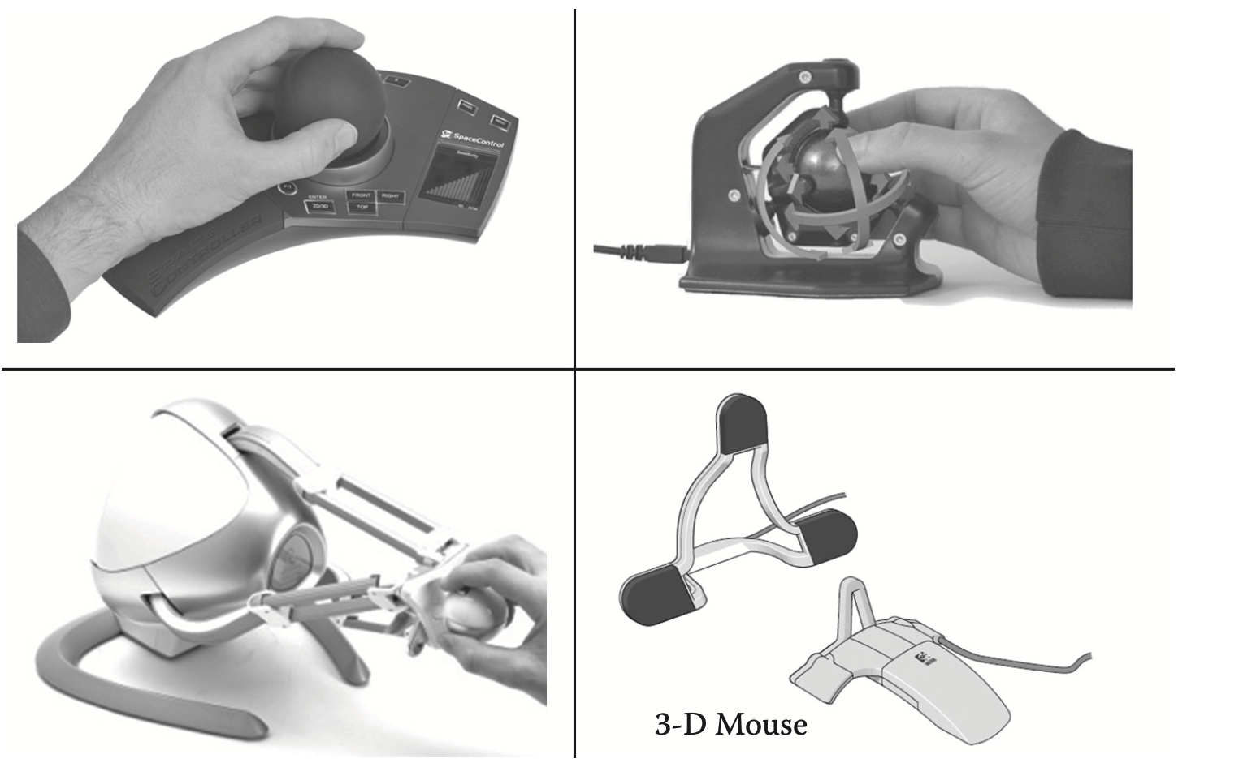
Human Computer Interaction
Chapter 9: Future of HCI
Examples of inside-out type (handheld) of sensors

Slide 13
Human Computer Interaction
Chapter 9: Future of HCI
Camera-based tracking has become increasingly attractive due to advancements in computer vision technologies and algorithms. These advancements include improved accuracy, faster processing speed, and lowered costs.
Virtually all modern devices such as smartphones, laptops, desktops, and smart TVs are equipped with high-quality cameras, making camera-based tracking widely accessible.
The increasing processing power of CPUs, GPUs, and multimedia processing chips enables more sophisticated tracking algorithms to be run efficiently.
Standard and free computer vision, object recognition, and motion tracking libraries such as OpenCV and OpenNI make it easier for developers to implement camera-based tracking.
Camera-based tracking performance can be affected by environmental factors such as lighting conditions.
To ensure robust tracking, markers such as high-contrast geometric patterns, colored objects, or infrared LEDs may be used. This approach somewhat resembles the inside-out method as it involves attaching or using external objects for tracking.

Slide 14
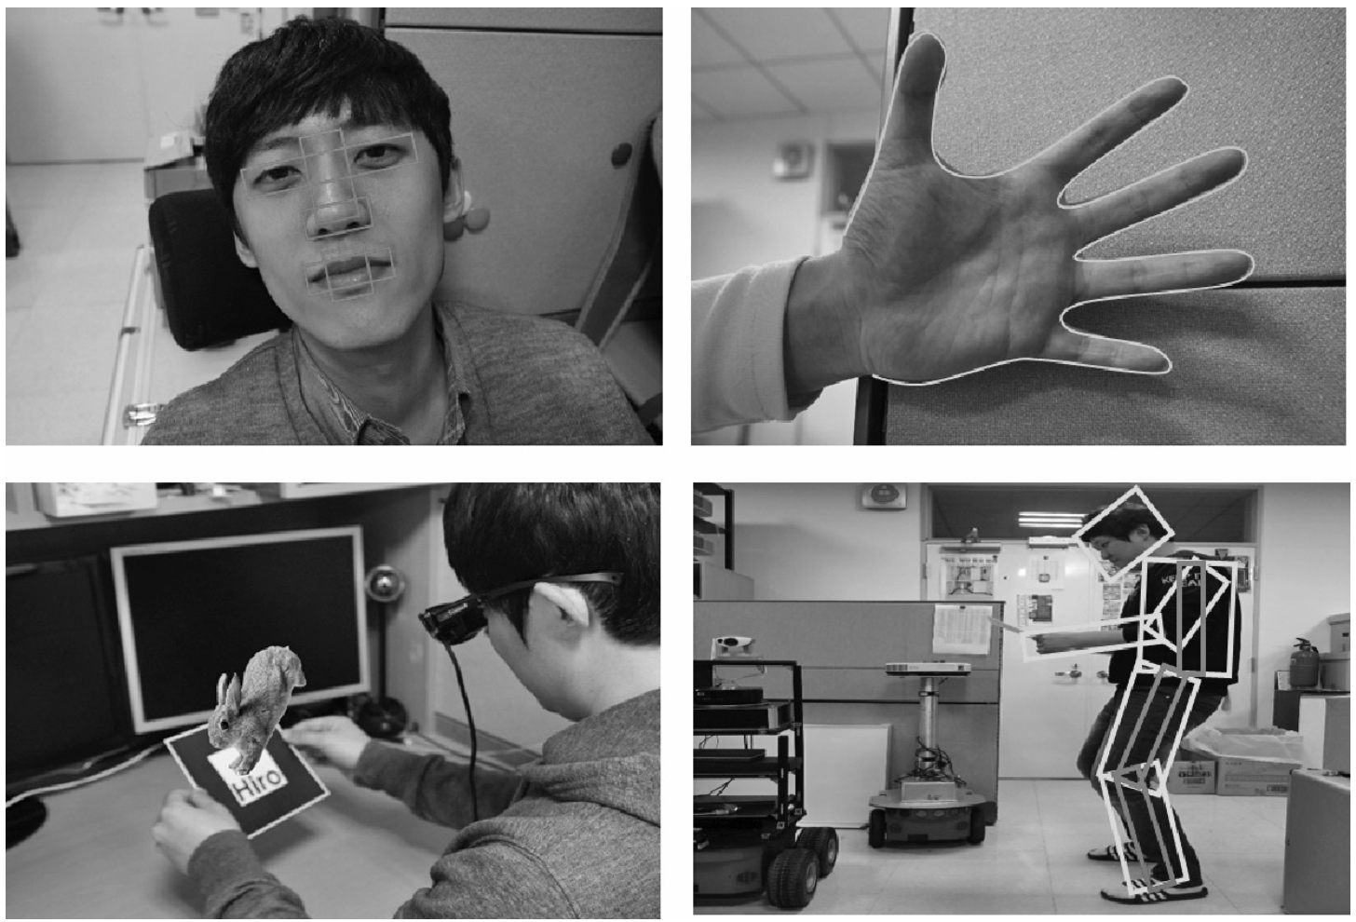
Human Computer Interaction
Chapter 9: Future of HCI
Camera-based motion-tracking examples

Slide 15
Human Computer Interaction
Chapter 9: Future of HCI
Recent introduction of low-cost depth sensors has transformed the effectiveness, reliability, and practicality of outside-in gesture and motion-based interactions.
The Kinect platform, utilizing both color cameras and depth sensors (originally developed by PrimeSense), can track whole-body skeleton motion of multiple users without requiring any devices to be worn. Originally designed for motion-based gaming, its applications have expanded to include environment reconstruction, motion capture, and more.
Beyond gaming, Kinect-like technologies are utilized for environment scanning to generate computer models, motion capture, and various other applications.
There's been development of smaller, miniaturized prototypes with comparable resolution and performance suitable for integration into mobile devices, enabling similar functionalities on a smaller scale.

Slide 16
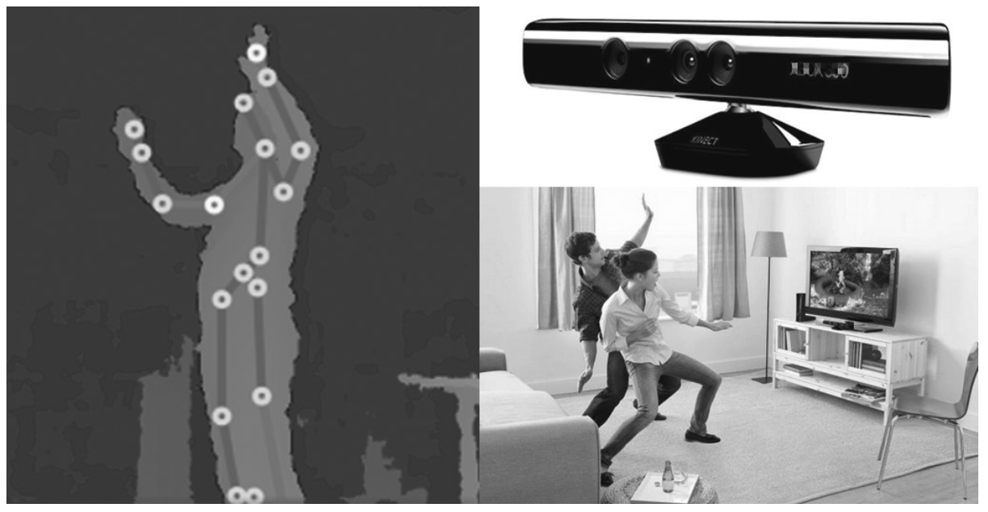
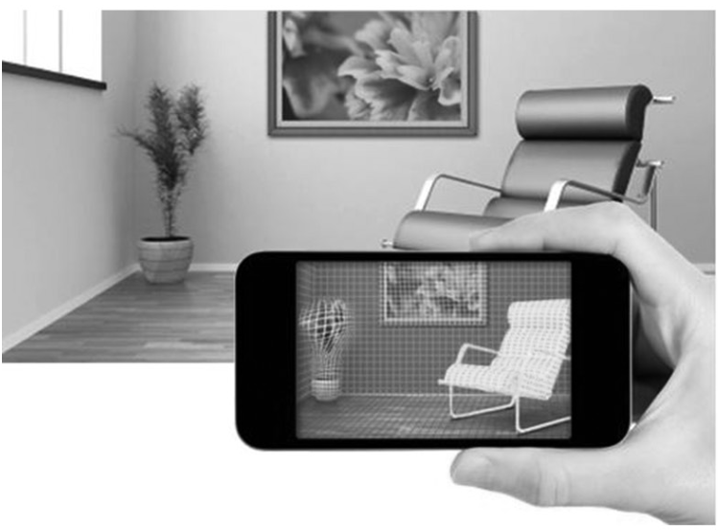
Human Computer Interaction
Chapter 9: Future of HCI
Prototype miniature depth sensor mountable on mobile devices.
Whole-body skeletonal tracking using the Kinect depth sensor (left) and its application to motion-based games (right).

Slide 17
Human Computer Interaction
Chapter 9: Future of HCI
Similar to the segmentation challenge in voice recognition, motion-based interaction faces difficulty in distinguishing meaningful gestures from continuous motion tracking data.
Many existing systems rely on specific modes or states to operate, such as pressing a button to activate gesture recognition. However, this undermines the seamless, natural interaction intended with bare hand and outside-in sensing, reducing usability.
New approaches, like those using "sliding windows" to continuously monitor motion streams for meaningful gestures, are being explored to address the segmentation problem.
Unlike voice recognition, where background noise may be minimal and spoken inputs intermittent, motion gestures often involve continuous movement, making it challenging to extract gestural commands.
Touch gesture is the same, it is natural to expect touches only when a command is actually needed. Thus a touch simply signals the start of the gesture input mode
Combining multiple modes of interaction can help mitigate the segmentation problem by providing additional contextual cues.
While motion-based interaction offers experiential and realistic experiences, it can also be physically tiring for users, highlighting the importance of balancing usability with functionality.

Slide 18
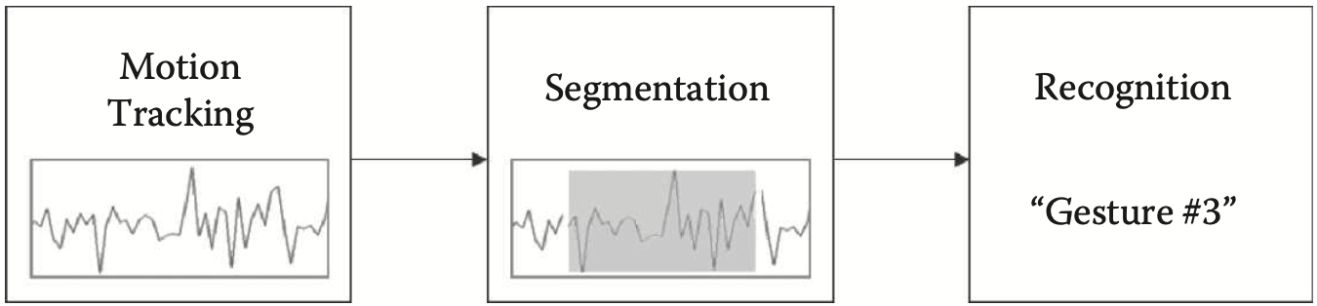
Human Computer Interaction
Chapter 9: Future of HCI
Three major steps in gesture recognition: (1) motion tracking, (2) segmentation (using the monitoring through the “sliding window” into the tracking data stream), and (3) recognition given the tracking data segment.
The sliding windows technique is a method used in pattern recognition to analyze sequential data by continuously monitoring a fixed or variable length of the data stream to detect meaningful patterns or gestures. It involves moving a window along the data stream and examining the data within the window to identify patterns or gestures.

Slide 19
Human Computer Interaction
Chapter 9: Future of HCI
Detecting subtle finger articulations is difficult due to current sensor resolutions and the small size of fingers compared to the human body.
Advances in sensor development and decreasing costs are mitigating this issue. Specialized depth sensors for finger tracking, like Leap Motion, are emerging in the market.
Finger tracking was previously handled with glove-type sensors, but these were cumbersome and had low usability.
Despite advancements, the usefulness of finger-based interaction in enhancing user experience (UX) is uncertain. In everyday life, fingers are primarily used for grasping rather than gestures, except in sign language. Even for touch-screen interaction, the number of finger-touch gestures is relatively small (e.g., swipe, flick, pinch).
Electromyogram (EMG) sensors are being explored for recognizing motion gestures by approximating joint movement. This technology could offer new possibilities for gesture recognition in gaming and other applications.

Slide 20
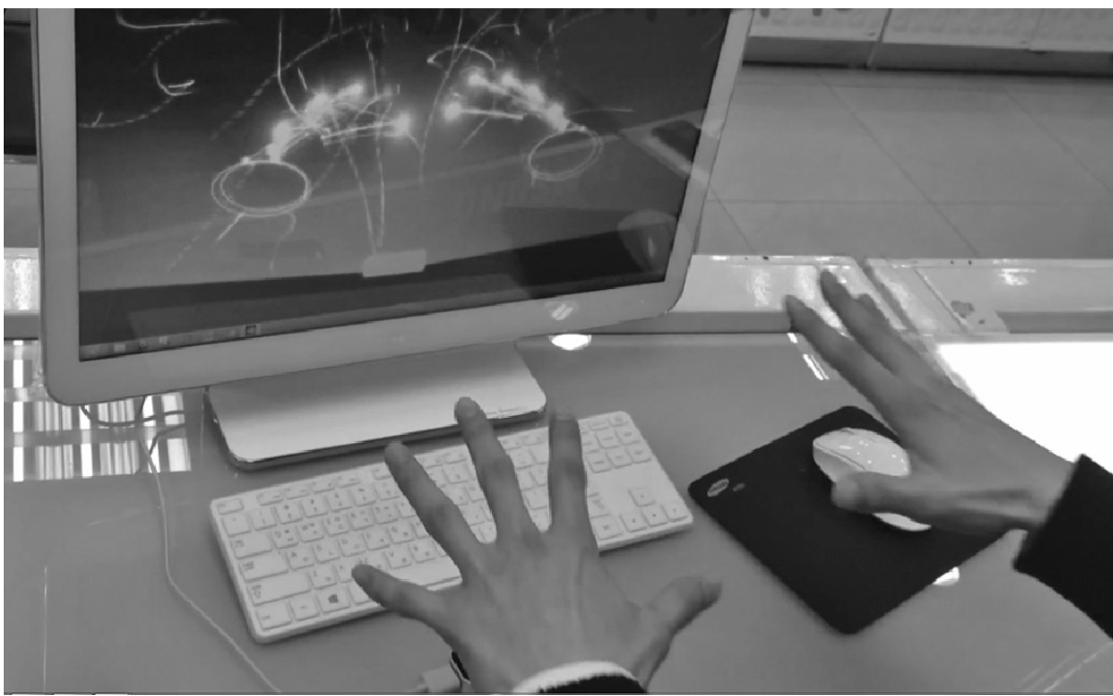
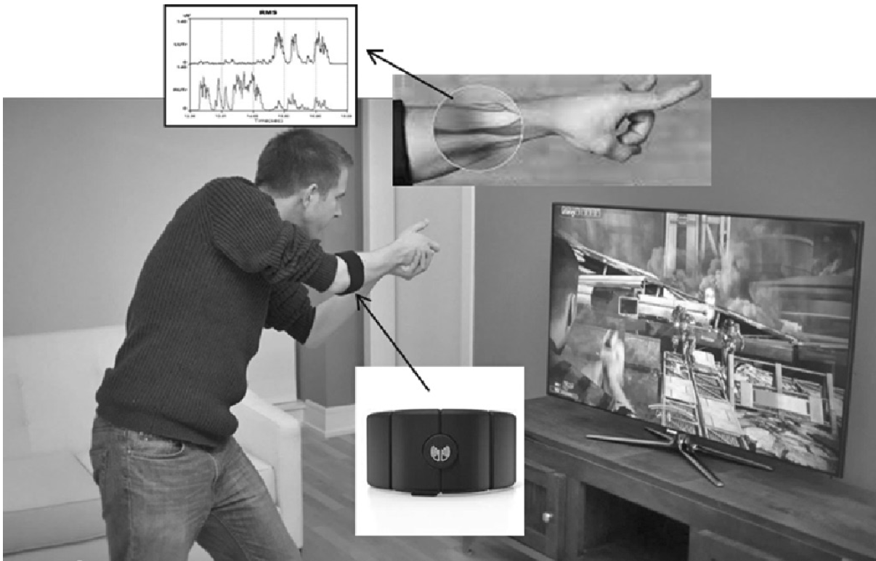
Human Computer Interaction
Chapter 9: Future of HCI
Finger-based interaction using the Leap Motion.
Wristband type of EMG sensor for simple gesture recognition
Electromyography (EMG) measures muscle response or electrical activity in response to a nerve's stimulation of the muscle.

Slide 21
Human Computer Interaction
Chapter 9: Future of HCI
Image Recognition and Understanding:
Image recognition in HCI is less common but has specific applications. For instance, face recognition is typically used for initial authentication.
Object image recognition can be an alternative to text-based searches.
Image recognition is more meaningful as an important part of object motion tracking. (e.g., face/eye recognition for gaze tracking, human body recognition for skeleton tracking, and object/marker recognition for visual augmentation and spatial registration).
Image understanding is crucial for mixed and augmented reality (MAR). MAR augments our environment with useful information. High-resolution cameras, GPUs, and smart glasses enable MAR's mainstream adoption. Cloud infrastructure enhances MAR's robustness and quality.
Image recognition supplements multimodal interaction. It extracts affect properties, disambiguates spoken words, and tracks lip movements.

Slide 22
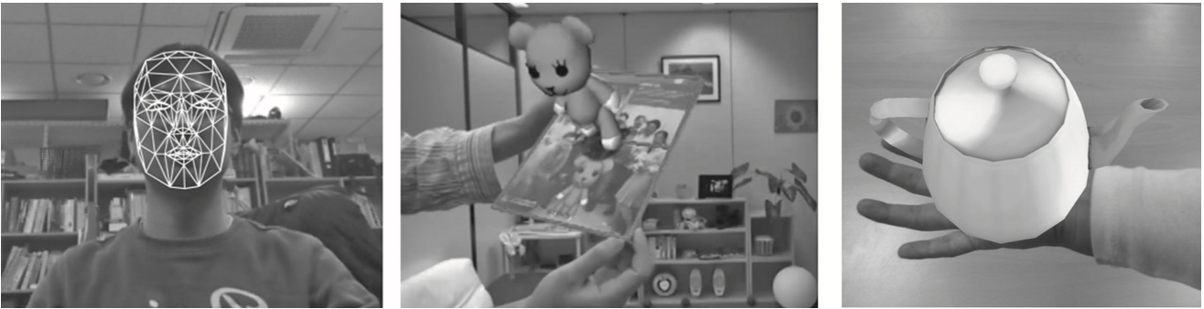
Human Computer Interaction
Chapter 9: Future of HCI
Image recognition for (a) face, (b) object/marker and (c) hand and their applications for motion tracking and augmented reality.

Slide 23
Human Computer Interaction
Chapter 9: Future of HCI
Multimodal Interaction:
Although high machine recognition rates (in some cases 100%). Usability is challenged by operational restrictions like ambient noise and interaction distance.Multimodal interaction addresses these challenges.
Academic research on multimodal interaction dates back to the 1980s, exemplified by MIT's "put that there" system.
Various ways of combining multiple modalities for eﬀective interaction have been devised. Although we have already outlined them in Chapter 3, we list them again here

Slide 24
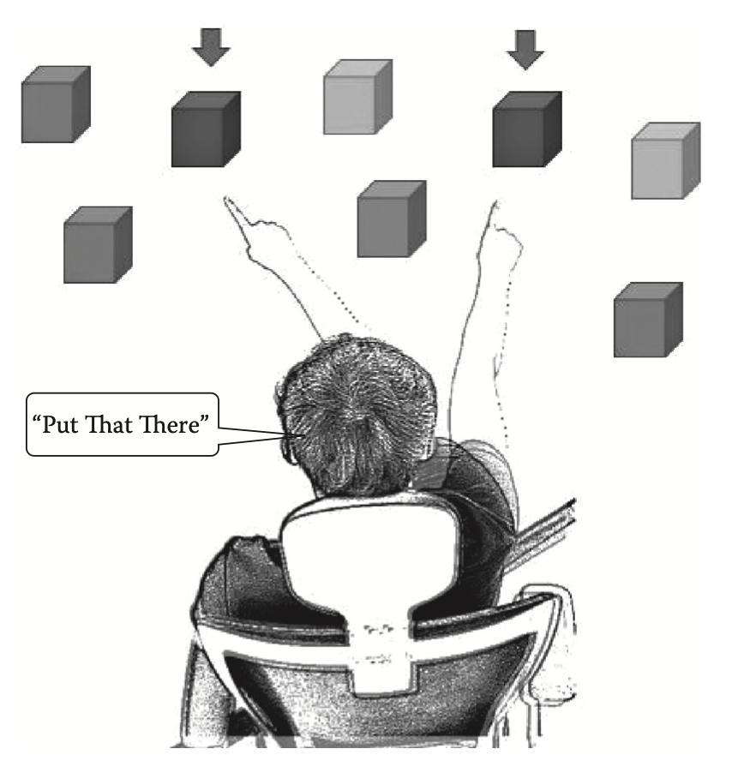
Human Computer Interaction
Chapter 9: Future of HCI
Bolt’s pioneering “put that there” system. The target object of interest is identified from voice and deictic gestures.

Slide 25
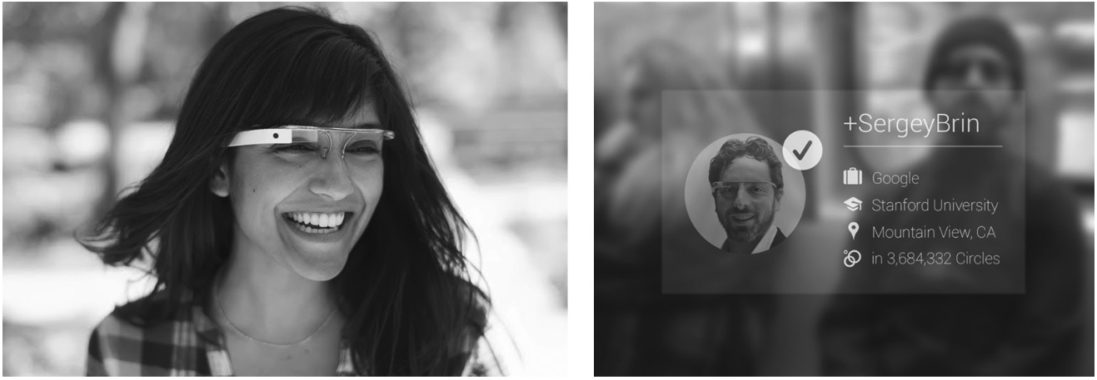
Human Computer Interaction
Chapter 9: Future of HCI
Applying image understating to information search and augmentation on a wearable display device

Slide 26
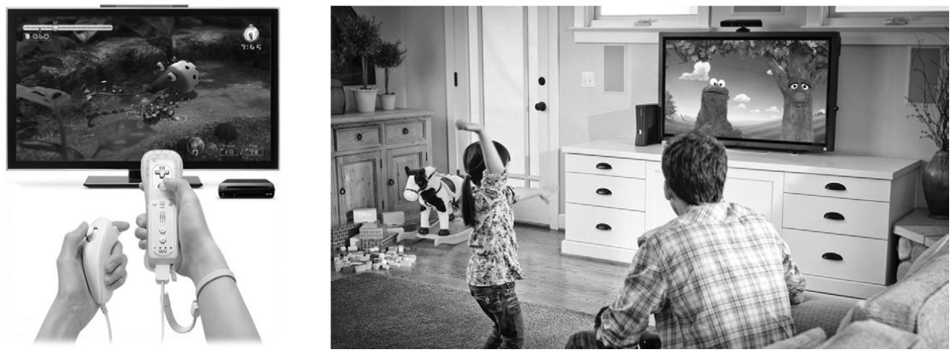
Human Computer Interaction
Chapter 9: Future of HCI
Multimodal interaction in games (left) using the buttons for setting selection and (right) action gestures for the game play itself

Slide 27
Human Computer Interaction
Chapter 9: Future of HCI
Composed:
In this approach, each subtask within a larger task is assigned the most suitable modality. Modalities fulfill different roles in the interaction.
Example: "put that there" system used voice for action command and deictic gesture for target identification.
In a game application, voice or touch interaction may be efficient for settings, while action gestures enhance gameplay.Multimodal interaction doesn't always involve simultaneous use of different modalities.
Alternative:
Multiple modal interaction techniques are used for the same subtask independently. The choice is made purely by user preference or by the operational situation.
When dialing in a regular situation, one might use the touch interaction, while during driving, voice interaction can be used instead

Slide 28
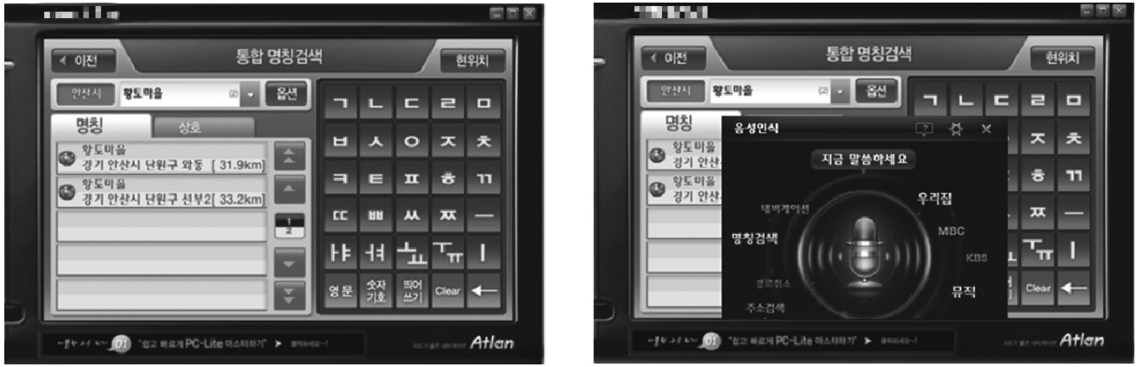
Human Computer Interaction
Chapter 9: Future of HCI
Redundant:
Many modalities are used together (simultaneously or not) for the same task (input or output)
It makes the act of conveying the intent or information much more robust by combining those of the individual.
An indication of an incoming phone call can use all three modalities: visual, aural, and tactile (vibration). With all three modalities in play, the user is less likely to miss a phone call

Slide 29
Human Computer Interaction
Chapter 9: Future of HCI
People often multitask in different modalities simultaneously ( walking, listening to music, and texting ). Multimodal interaction allows for parallel interaction to some extent. The extent of this ability is still a research question.
Effective parallel interaction requires independent tasks across modalities.
Shared resources among modalities can hinder multitasking.
Designing for multimodal interaction requires considerations like modality appropriateness (for the task), cognitive resource usage, synchronization (e.g., multiple modalities perceived as one event when temporally synchronized with a short amount of time), balance (e.g., one modality is not relatively dominating over another), and consistency (e.g., providing consistent information content between simultaneous multimodal input/output).

Slide 30
Human Computer Interaction
Chapter 9: Future of HCI
Mobile and Handheld Interaction:
Smartphones have largely replaced PCs for casual and business computing, elevating the importance of usability and UX for mobile interaction.
Is a focal point toward which the two notable future trends are converging: (a) multimodal interaction (with all the on-mobile sensors and displays) and (b) cloud-based services (through high-speed wireless communication).
More research is needed in the ergonomic aspects of multimodal interaction for the active (e.g., while moving), dynamic (e.g., frequently changing operating environment), and multitasking lifestyle.
One notable trend in the mobile interaction is the simple and quick approach (vs. the rich experiential approach)
People prefer simple and quick interfaces, even for entertainment like mobile games. Successful mobile games are often "casual," with short play sessions and simple controls. Home-based computing platforms offer more immersive experiences in a relaxed setting.

Slide 31
Human Computer Interaction
Chapter 9: Future of HCI
A significant cloud service is the sensor network, comprising environmental sensors coordinated through the cloud.
Sensor networks enhance mobile sensors, offering contextual insights like location, lighting, time, and nearby activity.
This improves personalized user experience on mobile devices.

Slide 32
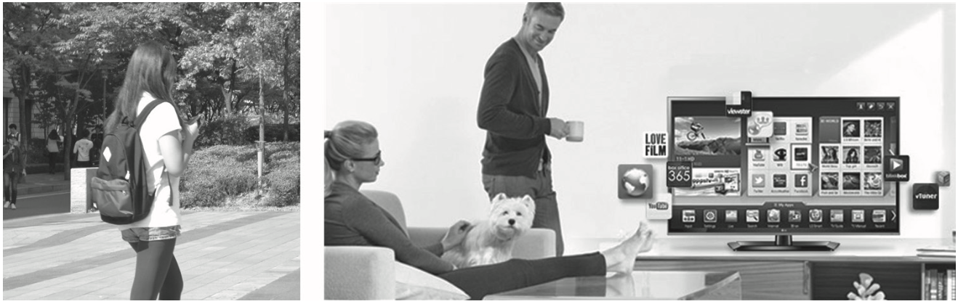
Human Computer Interaction
Chapter 9: Future of HCI
Two bipolar directions in future interaction style: (a) “simple and quick” mobile/ handhelds and (b) rich and experiential stationary platforms at home.

Slide 33
Human Computer Interaction
Chapter 9: Future of HCI
Natural/Immersive/Experiential Interaction:
Modern smart TVs have computing power similar to high-performance PCs. Equipped with network connections, they serve as entertainment hubs.
Large screens (over 42 inches) with UHD resolution, Stereoscopy and 5.1 surround soun, Integrated sensors: cameras, depth sensors, microphones, Connectivity: fiber-optic and land-line network connections.
Potential developments include haptic sofas, living-room table computing, and olfactory displays.
Transition from entertainment to other fields:
Immersive teleconferencing for home offices.
VR-based training and education.
Crucial for future VR/immersive/natural UI content.
Emerging tools with advanced capabilities beyond game development and multimedia editing.

Slide 34
Human Computer Interaction
Chapter 9: Future of HCI
Mixed and Augmented Reality (MAR)
Mixed Reality (MR): Combines real and virtual worlds with varying proportions of each.
Augmented Reality (AR): Predominantly real-world content with some virtual elements.
Augmented Virtuality (AV): Predominantly virtual content with some real-world elements.
Virtuality or Mixed Reality Continuum: Concept describing the spectrum from purely real environments to purely virtual environments.
Core Technologies for MAR:
Object Recognition: Identifying real-world objects to integrate virtual elements accurately.
Tracking: Monitoring the position and orientation of objects to maintain correct spatial registration.
Spatial Registration:
Augmentation is precisely placed next to or on the targeted real-world object.
Example: Overlaying virtual furniture onto a real room layout.

Slide 35
Human Computer Interaction
Chapter 9: Future of HCI
Looser Forms of MAR:
Augmentation displayed anywhere on the screen without precise spatial registration.
Example: Google Glass projects information onto see-through glass at a fixed position in the visual field.
Applications and Benefits:
Enhances usability and user experience (UX) by integrating additional information with real-world objects.
Allows for instant recognition and access to information, improving interactions with everyday objects.
Examples
Google Glass: Projects information on see-through glass at a fixed visual position.
Furniture Visualization Apps: Overlay virtual furniture onto a real room to help with interior design decisions.

Slide 36
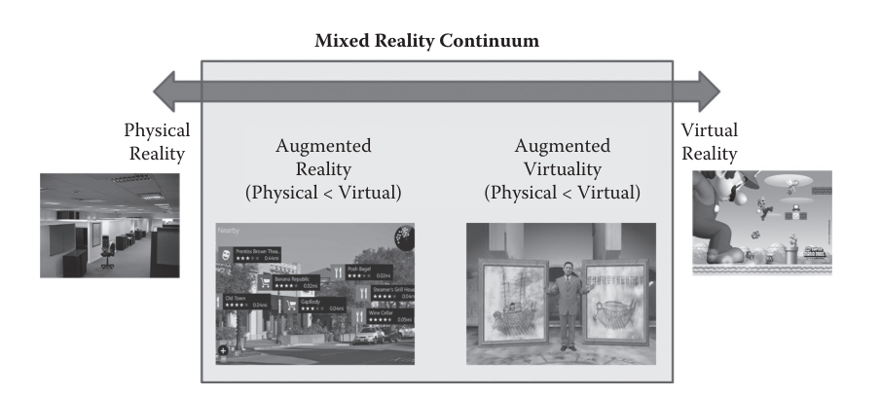
Human Computer Interaction
Chapter 9: Future of HCI
Mixed reality/virtuality continuum [10]. A spectrum is formed according to the relative proportion of the real and virtual representations in the content. At the extremes of the continuum, there is the completely real environment and the purely virtual environment.

Slide 37
Human Computer Interaction
Chapter 9: Future of HCI
Others
Wearable computing and interaction:
The smartphone, while almost undetachable from many users, is not a true form of wearable computer. The concept of a wearable computer started from the idea of embedding computers and interaction devices into clothes and things we wear (e.g., hats, belts, shoes, glasses). This integration of “wears” and computing devices has not advanced as much as expected during the last decades in terms of both technology and usability. Even the Google Glass concept is facing practical problems such as its weight, power, and privacy issues. It is still questionable whether computer elements need to be interwoven into our “wears” (except for very special applications).

Slide 38
Human Computer Interaction
Chapter 9: Future of HCI
Interaction based on physiological signals:
Much research has been conducted in ways to take advantage of our physiological signals such as brain waves, EMG (electromyography), ECG (electrocardiography), and EEG (electroencephalography). It seems very difficult to extract human intention in a useful and major way for HCI from these raw signals. This line of research will probably focus on the HCI for disabled people.
Eye/gaze tracking and interaction:
HCI is deeply connected with the line of sight. When interacting, we mostly tend to
look at the target interaction object. Tracking of the line of sight is often done by tracking the head direction, rather than the eyeballs themselves. In many cases, it is safe to assume that the front head direction is the direction the eyes are looking. There are not too many applications in which the exact eyeball/gaze direction is so important (except maybe for gaze analysis).

Slide 39
Human Computer Interaction
Chapter 9: Future of HCI
Interaction based on physiological signals:
Much research has been conducted in ways to take advantage of our physiological signals such as brain waves, EMG (electromyography), ECG (electrocardiography), and EEG (electroencephalography). It seems very difficult to extract human intention in a useful and major way for HCI from these raw signals. This line of research will probably focus on the HCI for disabled people.
Eye/gaze tracking and interaction:
HCI is deeply connected with the line of sight. When interacting, we mostly tend to
look at the target interaction object. Tracking of the line of sight is often done by tracking the head direction, rather than the eyeballs themselves. In many cases, it is safe to assume that the front head direction is the direction the eyes are looking. There are not too many applications in which the exact eyeball/gaze direction is so important (except maybe for gaze analysis).

Slide 40
Human Computer Interaction
Chapter 9: Future of HCI
Facial/emotion based input:
Affective interfaces based on aesthetic look and feel and on more humane output feedback may be important and emerging techniques for improving UX. However, as an input method, it seems we have a long way to go. Input based on user emotion (e.g., facial expression, tone of voice, particular gestures) is very difficult even for humans themselves, and thus would be very difficult to be used as a robust means of interaction
Finger-based interaction:
As explained in Section 9.1.2, finger based interaction has been pursued through the use of gloves. Depth-based sensing has recently allowed finger tracking and interaction without the inconvenience of having to wear a glove. Again, not too many applications can be found where finger based interaction can be applied in a natural way. Contrived finger gestures can be used, but they generally incur low usability

Slide 41
Human Computer Interaction
Chapter 9: Future of HCI
3-D/stereoscopic GUI:
Interacting by manipulating 3-D GUIs (in stereo) has been depicted in many science fiction movies. However, there are not many computer tasks that require precise 3-D motions. Most system commands are easier with voice or the familiar 2-D cursor control.
Context-based interaction:
Similar to the case with the emotion-based input, inferring “context” in hopes of adapting to the operational situation at hand or of personalizing the interface to the user is very difficult. The true user intent is not always clearly manifested explicitly and capturable/interpretable by the sensors and AI.

